Slide 1
p-2022-040
Bar Moskovich Noam Galili
Supervisors:
Prof. Mor M. Peretz
Mr. Guy Bar Sovik
Multi Sources Docking Station
The Center for Power Electronics and Mixed-Signal IC
Department of Electrical and Computer Engineering
Ben-Gurion University of the Negev, ISRAEL
Website: http://www.ee.bgu.ac.il/~pemic
June 2022

Slide 2
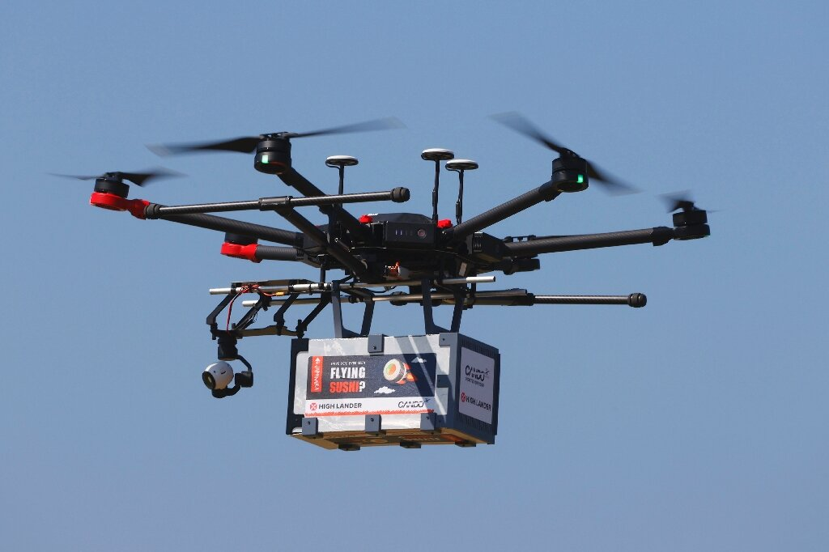

Introduction
Various industry uses
Limited battery lifetime
Different energy sources

Slide 3
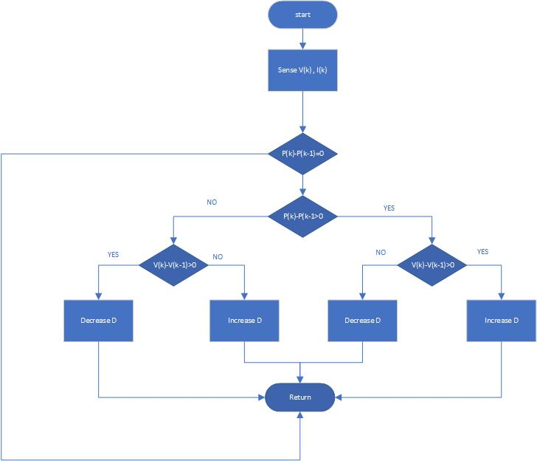
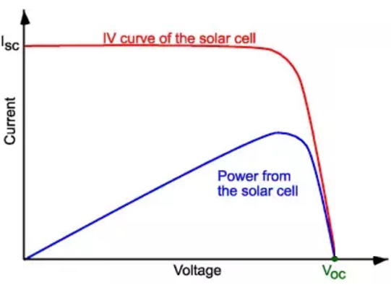
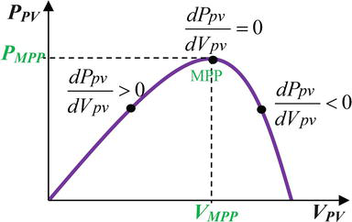
PV Characteristics
Power curve depends on temperature, irradiance etc.
MPP Tracking- Maintaining work around an optimal working point

Slide 4
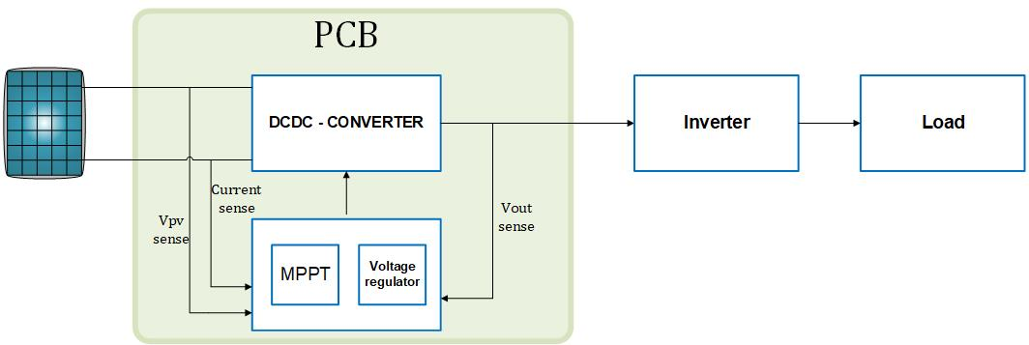
Project Spec
Efficiency: ~ 95%
Output voltage: 400V
Max output power: 240 W
Input voltage: 20-40 V

Slide 5

Challenges
Components selection
High efficiency- Zero voltage switch
High resonance current
High power density

Slide 6
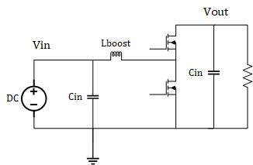
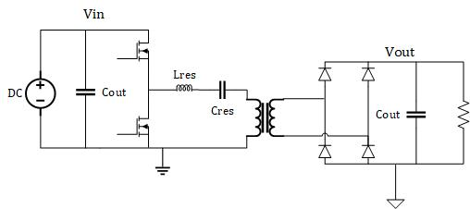



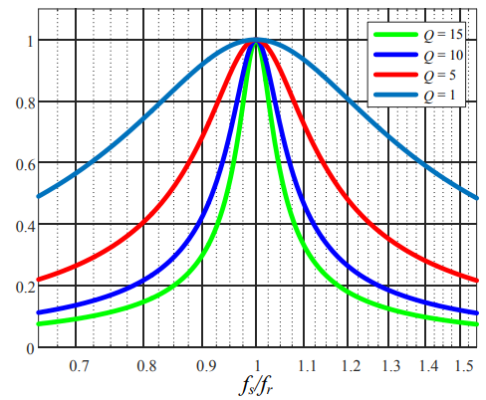
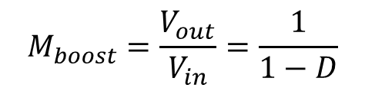
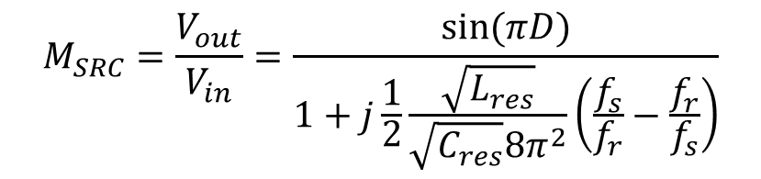
Boost Converter
Resonant Converter
$$M_{SRC}=\frac{V_{out}}{V_{in}}=\frac{sin⁡(πD)}{1+j\frac{1}{2}\frac{\sqrt{L_{res}}}{\sqrt{C_{res}}8π^{2}}\left(\frac{f_{s}}{f_{r}}−\frac{f_{r}}{f_{s}}\right)}$$
$$M_{boost}=\frac{V_{out}}{V_{in}}=\frac{1}{1−D}$$

Slide 7

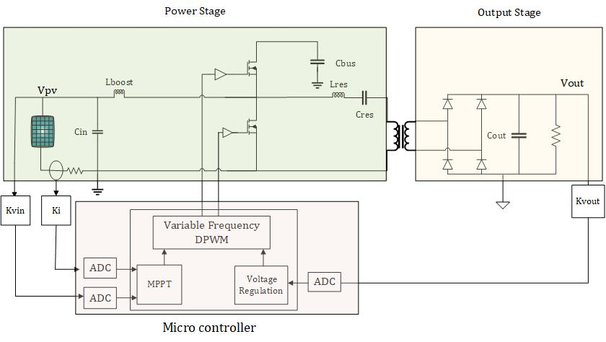

Merged PWM Resonant Converter
$$\frac{V_{out}}{V_{PV}}=M_{boost}M_{SRC}$$

Slide 8
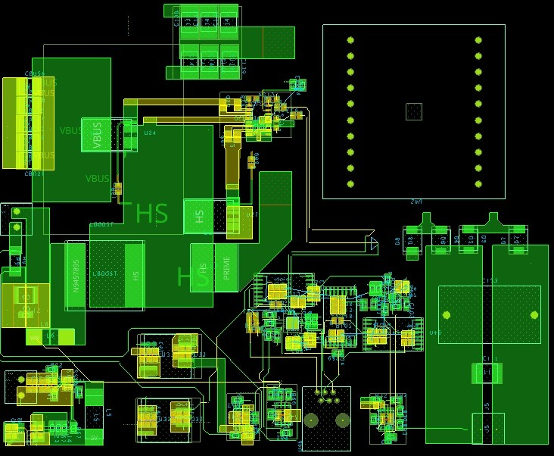
PCB Design
Boost
Output stage
Control

Slide 9

Conclusions
Charging by using renewable energy
Independently control duty cycle and switch frequency allow us to stable the output voltage while achieving stable output.

Slide 10

Future work
Hardware implementation
Control implementation
Wireless charging
Inverter implementation

Slide 11
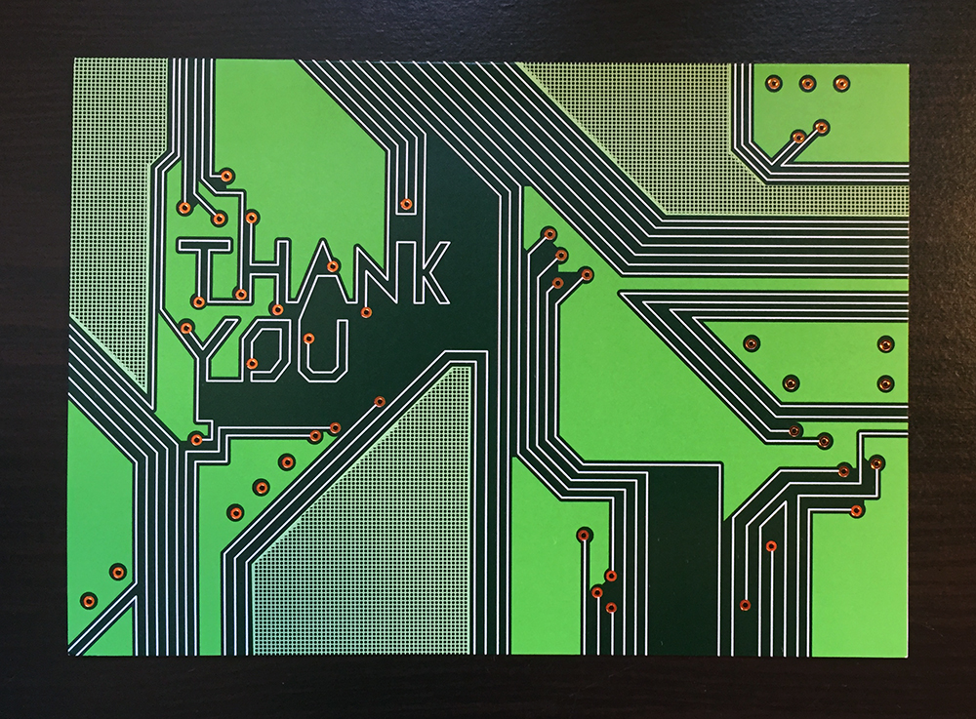

Slide 12
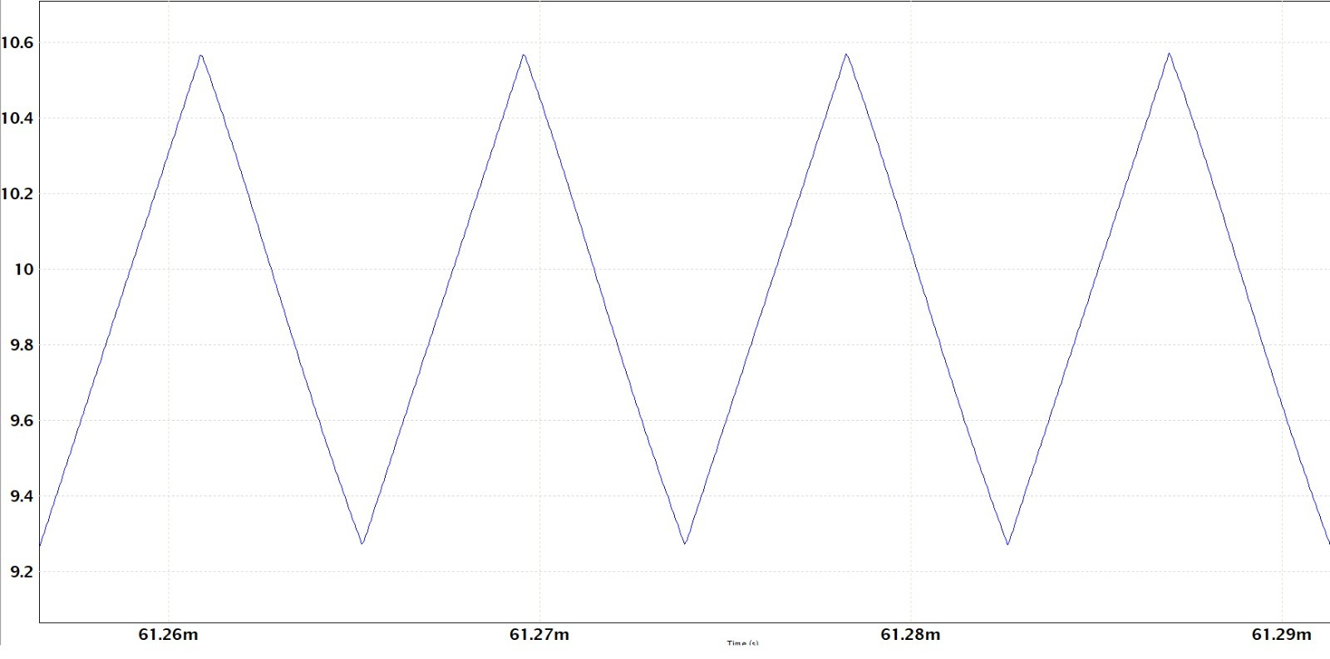
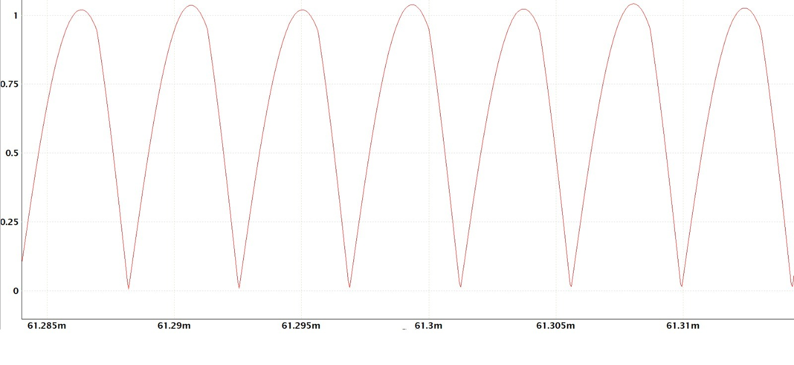
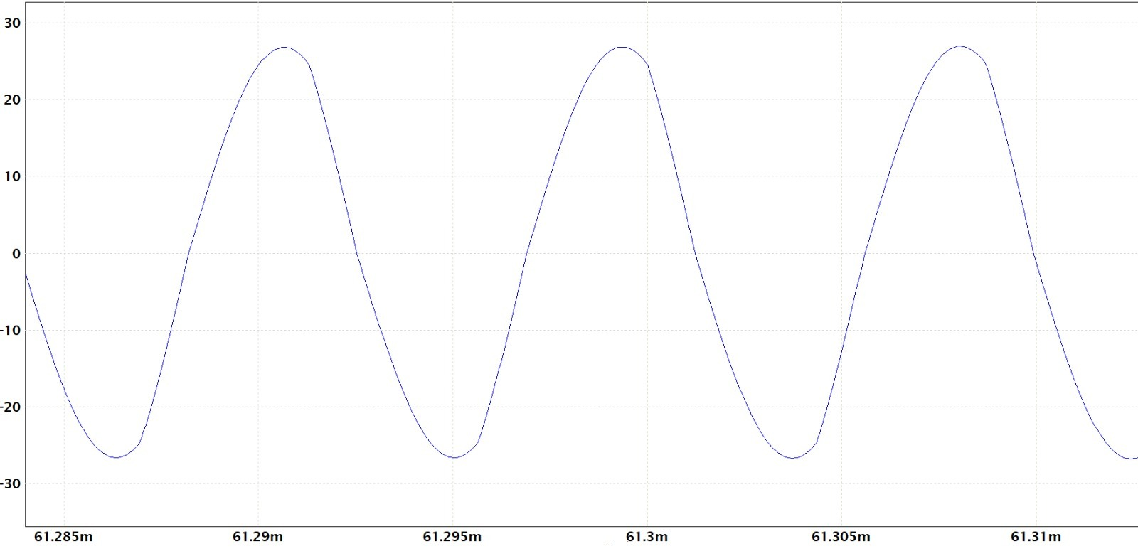
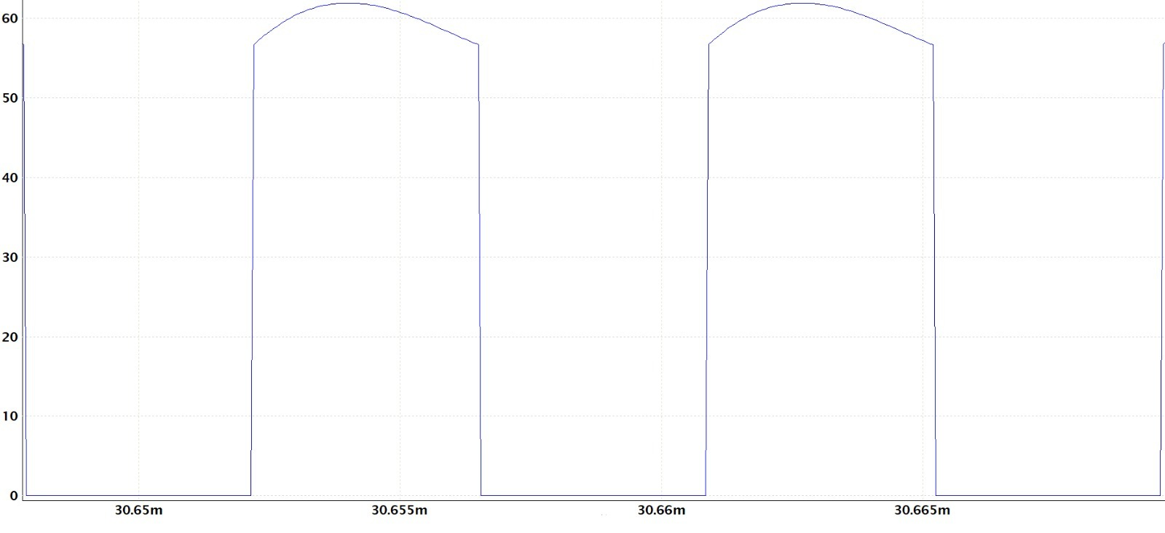
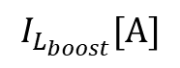
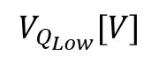
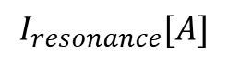
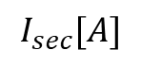
Circuit Simulation
$$I_{L_{boost}}[A]$$
$$I_{sec}[A]$$
$$I_{resonance}[A]$$
$$V_{Q_{Low}}[V]$$

Slide 13
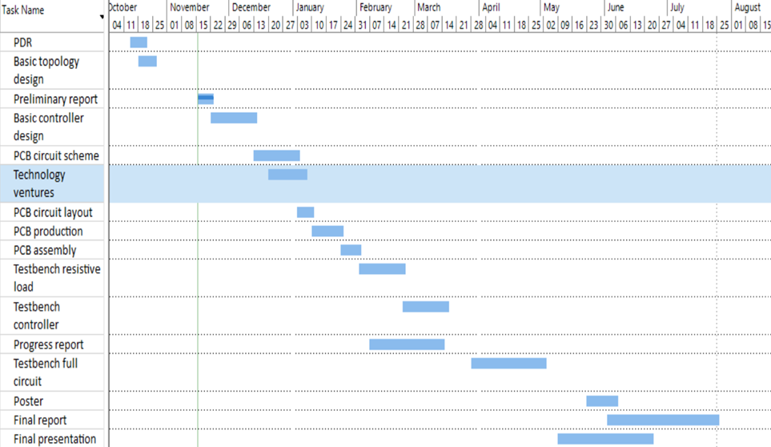

Project’s Tasks

